Slide 1



Controle_Vendas
View in Power BI
Last data refresh:
11/02/2025 18:00:50 UTC
Downloaded at:
11/02/2025 18:05:18 UTC

Slide 2

Capa
Notes:
image
No alt text provided
image
No alt text provided
image
No alt text provided
image
No alt text provided
image
No alt text provided
shape
No alt text provided
textbox
No alt text provided
image
No alt text provided
textbox
No alt text provided
CLICK AQUI
No alt text provided

Slide 3
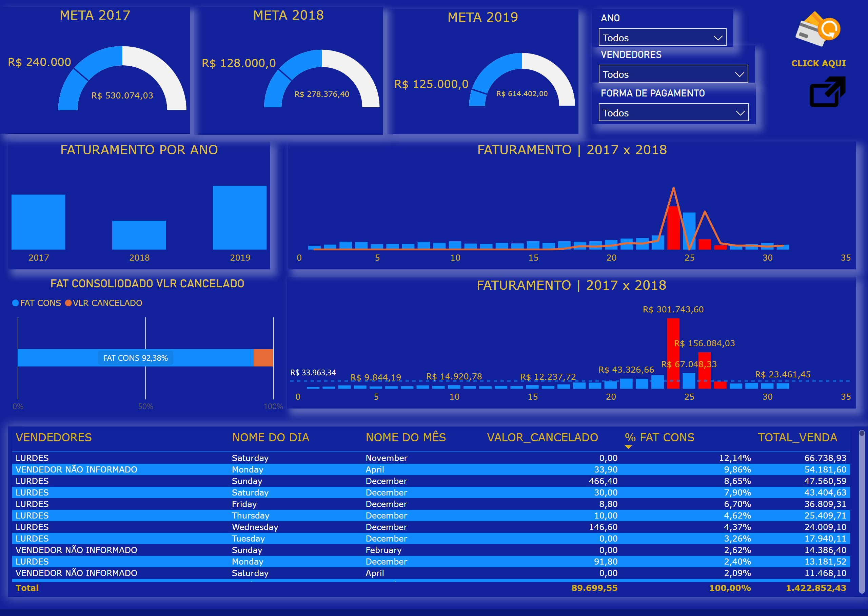
Consolidada
Notes:
META 2017
No alt text provided
META 2019
No alt text provided
META 2018
No alt text provided
FATURAMENTO POR ANO
No alt text provided
slicer
No alt text provided
image
No alt text provided
slicer
No alt text provided
slicer
No alt text provided
FATURAMENTO | 2017 x 2018
No alt text provided
FAT CONSOLIODADO VLR CANCELADO
No alt text provided
FATURAMENTO | 2017 x 2018
No alt text provided
CLICK AQUI
No alt text provided
tableEx
No alt text provided

Slide 4
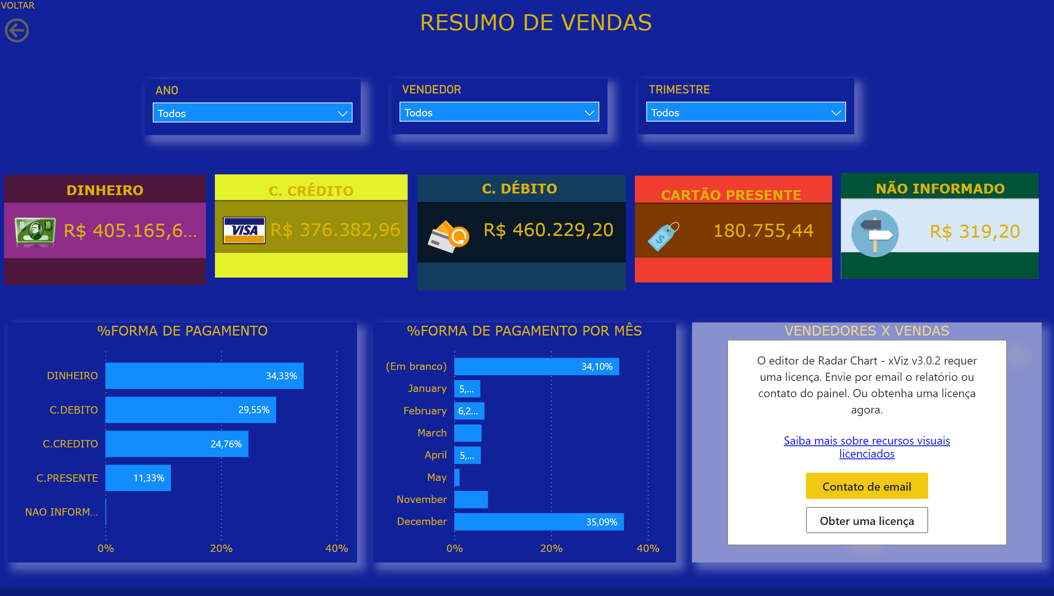
Resumo de Vendas
Notes:
image
No alt text provided
image
No alt text provided
image
No alt text provided
image
No alt text provided
image
No alt text provided
DINHEIRO
No alt text provided
image
No alt text provided
C. CRÉDITO
No alt text provided
image
No alt text provided
C. DEBITO
No alt text provided
image
No alt text provided
image
No alt text provided
image
No alt text provided
C. DEBITO
No alt text provided
C. DEBITO
No alt text provided
textbox
No alt text provided
textbox
No alt text provided
textbox
No alt text provided
textbox
No alt text provided
textbox
No alt text provided
%FORMA DE PAGAMENTO
No alt text provided
%FORMA DE PAGAMENTO POR MÊS
No alt text provided
VENDEDORES X VENDAS
No alt text provided
slicer
No alt text provided
slicer
No alt text provided
slicer
No alt text provided
VOLTAR
No alt text provided
textbox
No alt text provided

